Slide 1
The Book of Daniel

Slide 2
Two Main Parts
The Man, The Prophet—Chapters 1-6
His Message, The Prophecies—Chapters 7-12
Porphyry—3rd Century
Karl Barth
Job 11:7-8
Jesus believed the book of Daniel and
called Daniel a prophet—Mt.24:15

Slide 3
Chapter One
v.1—Nebuchadnezzar II
2nd king of the Neo-Babylonian Empire,
after his father, Nabopolassar
Isa.39:6
Hab.1:6
Ezek.14:14, 20
Dan.6:4, 5

Slide 4
Chapter One
v. 8—Daniel purposed in his heart that he would not defile himself
An Unashamed Boldness
An Uncommon Standard
An Unearthly Protection
An Unhindered Persistence
An Unblemished Faith
An Unusual Test
An Unmeasurable Blessing
An Unlimited Influence

Slide 5
Cadet Prayer from West Point
“Make us choose the harder right instead of the easier wrong,
And never to be content with a half-truth
when the whole can be won.
Endow us with courage that is born of loyalty to all that is noble and worthy,
that scorns to compromise with vice and injustice,
and knows no fear when right and truth are in jeopardy.
All of which we ask in the name of the Great Friend and Master of all.
Amen.

Slide 6
Chapter Two
Nebuchadnezzar
First year of reigning alone—605/604 BC
Second year—604/603 BC
Dream while asleep
Vision while awake

Slide 7
The Occult World
They can do wonders with information you give them.
The wise men asked for time and didn’t get it.
Daniel asked for time and got it.
Daniel offered to be the channel for what the wise men said nobody could do.
Daniel and his friends knew where they stood, so they went to their knees.

Slide 8
Daniel is merely a mirror reflecting God to Nebuchadnezzar
When God wants to drill a man
And thrill a man
And skill a man
When God wants to mold a man to play the noblest part
When God yearns with all his heart to create so great and bold a man
That all the world shall be amazed

Slide 9
Watch his methods
Watch his ways
How he ruthlessly perfects
Whom he royally elects
How he hammers him, and hurts him
And with mighty blows converts him
Into trial shapes of clay
Which only God understands.

Slide 10
While his tortured heart is crying
And he lifts beseeching hands
How God bends
But never breaks
When his good he undertakes
How He uses whom He chooses
And with every purpose fuses him
By every act induces him
To try His splendor out
God knows what He’s about.

Slide 11
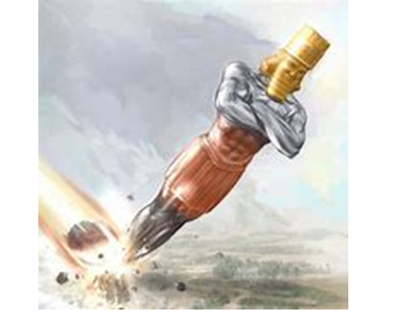

Slide 12
The Backbone of Biblical Prophecy
Gold—Babylon
Silver—Medo-Persia
Bronze—Greece
Iron—Rome
Stone—Kingdom of Christ

Slide 13
Four World Empires
Babylon—burnt idolatry out
Medo-Persia—sent Jews home
Greece—lingua franca for N.T.
Rome—paved roads, Pax Romana

Slide 14
Dreams
One of the “divers manners” God used to speak to people in earlier ages.
Dreams today are not information from God, who now speaks to us through his completed word.

Slide 15
Names
Daniel—God is my judge
Belteshazzar—May Bel protect his life
Hananiah—Jehovah is gracious
Shadrach—Command of Aku
Mishael—Who is what God is?
Meshach—Guest of a king
Azariah—Jehovah has helped
Abednego—Servant of Nego (Nebo)

Slide 16
Chapter Three
Two Main Themes:
Idolatry
Suffering

Slide 17
v.1
60 cubits x 6 cubits
Sexegesimal mathematical system
Image of Gold
Septuigint—18th year of Nebuchadnezzar?

Slide 18
Vs.2-3
Shema—Deut 6:5
2nd Commandment

Slide 19
Vs.8 &12
Accused the Jews
“There are certain Jews”
Antisemitism

Slide 20
vs.14,15
“Is it true?”
2nd Chance

Slide 21
Vs.16-18
Even if God doesn’t save us, we’ll still serve Him.

Slide 22
Vs. 21,23,24— “bound”
v.25— “loose”
The only thing burnt was that which bound them.
When through fiery trials thy pathway shall lie
My grace, all sufficient, shall be thy supply
The flame shall not hurt thee, I only design
Thy dross to consume, thy gold to refine.

Slide 23
The Hammer
The File
The Furnace

Slide 24
Chapter Four
Insomnia, Insanity, Insight

Slide 25
Vs.1-3
Universal Declaration

Slide 26
v.4
eight years earlier

Slide 27
v.5
He can buy anything but sleep.

Slide 28
v.6
Does this sound familiar?

Slide 29
v.8
Eight years ago, my god was Bel.

Slide 30
v.9
He still sees Daniel as a magician, not a prophet of Jehovah.

Slide 31
Vs.10-17: The Dream
v.12—Nebuchadnezzar nurtured the world
v.13—angel
v.15,16— “him”, “his”
Man—reason, conscience, will, affection
Beast—sensation, passion, instinct
Times=Years
v.17—to show that the Most High Rules

Slide 32
v.19
Daniel is in shock for an hour.
He spoke the thing he had to speak.

Slide 33
v.20-26—The Interpretation
v.22—the tree is you.
v.25—the Most High Rules
v.26—the stump is left
v.27—confrontation

Slide 34
v.28
All this came upon Nebuchadnezzar
v.29—a year later

Slide 35
v.30
Shows how far a pompous fool was from repenting
Babylon a 15 miles square
Population 1,200,000
53 palaces
Hanging Gardens
60 million bricks
Saddam Hussein wanted to be another Nebuchadnezzar.

Slide 36
v.31
While the word was in his mouth
v.32—the Most High Rules (3rd time)
v.33—a delusional lunatic for seven years
Clinical Zoanthropy—the conviction of having turned into an animal
Dr. Raymond Harrison

Slide 37
v.34
Understanding Returned
Jeremiah 9:23
v.36—I was established in my kingdom
v.37—Praises the one true and living God
This is the last we read of Nebuchadnezzar.
Ecc.8:11

Slide 38
One by one God took them from me
All the things I valued most
Till I was empty handed
Every glittering toy was lost
And I walked earth’s highway grieving
In my rags and poverty
Till I heard His voice inviting
Lift those empty hands to me

Slide 39
Then I turned my hands toward heaven
And He filled them with a store
Of his own transcendent riches
Till they could contain no more
And at last I comprehended
With my stupid mind and dull
That God could not pour his blessings
Into hands already full.

Slide 40
Chapter Five
In Daniel, every chapter except the last one begins with a sentence including the name of the ruling monarch.

Slide 41
Neo-Babylonian Kings
626-605—Nabopolassar
605-562—Nebuchadnezzar II
562-560—Amel-Marduk (Evil-Merodach)
560-556—Neriglissar
April 556-June 556—Labashi-Marduk
(Laborosoarchod)
556-539—Nabonidus
Belshazzar

Slide 42
Belshazzar
36 years old
v.2-4—banquet
v.5—October 12, 539 BC
The Handwriting on the Wall
v.6—terror
v.10—Nitocris, queen regnant
v.13—Daniel in his 80s
v.17—read it, and make interpretation known

Slide 43
The Fall of Babylon
ME’NE ME’NE TEKEL U-PHAR’SIN
Numbered Numbered Weighed Divided
(ended)
v.26-28—the interpretation
Jeremiah 27:4-7
Isaiah 13:1, 15-22
Daniel 5:5, 30-31

Slide 44
At the feast of Belshazzar and a thousand of his lords
While they drank from golden vessels, as the book of truth records
In the night as they reveled in the royal palace hall
They were seized with consternation at the hand upon the wall.

Slide 45
See the brave captive Daniel as he stood before the throng
And rebuked the haughty monarch for his mighty deeds of wrong
As he read out the writing, ‘twas the doom of one and all
For the kingdom was now finished, said the hand upon the wall.

Slide 46
See the faith and zeal and courage that would dare to do the right
Which the Spirit gave to Daniel, this the secret of his might
Stolen from his home, Judea; captive in a pagan hall,
He still understood the writing of his God upon the wall.

Slide 47
So our deeds are recorded, there’s a hand that’s writing now
Sinner, give your heart to Jesus; to His royal mandate bow
For the day is fast approaching, it must come to one and all
When a sinner’s condemnation will be written on the wall.

Slide 48
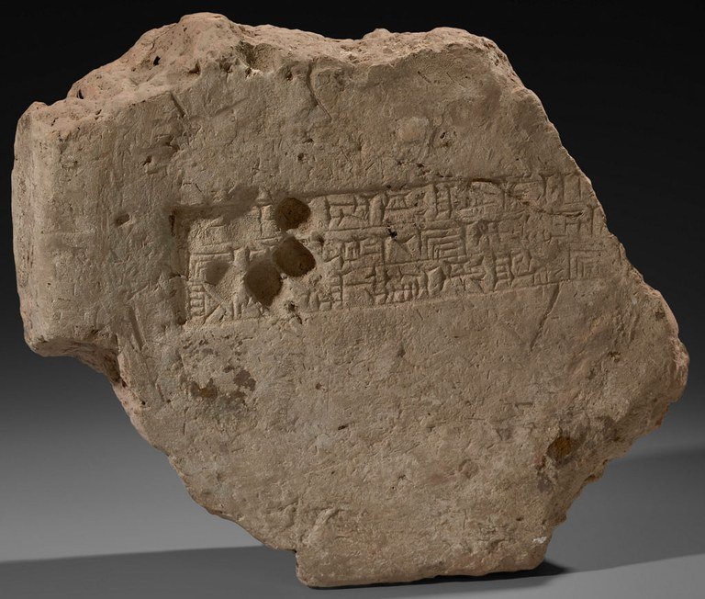

Slide 49
Chapter Six
Noah and the ____
David and _______
Samson and ______
Elijah under the _______ _____
Jonah and the ______
Moses crossing the _____ ____
Joshua and the battle of ______
Daniel in the _____ ______

Slide 50
Darius the Mede
5:30-31—about 62 years old
Inferior Kingdom (2:39)
6:1-2—inferior form of government
120 satraps
Three Presidents
v.3—an excellent attitude

Slide 51
v.4
Proverbs 20:6—Most men will proclaim their own goodness, but a faithful man, who can find?

Slide 52
v.5
Except we find it against him concerning the law of his God.

Slide 53
v.7
Lion’s Den
Zoroastrians

Slide 54
v.8
As unalterable as the laws of the Medes and Persians
v.10—a consistent walk with God

Slide 55
God is still on His throne.
Man is still on God’s footstool.
There’s only a knee’s distance in between.

Slide 56
v.11-15
You seldom get what you deserve from people—don’t expect it.
You always get what is best from God—don’t doubt it.

Slide 57
Parallels
1 Pet.2:13—Submit yourselves unto every ordinance of man for the Lord’s sake.
Dan.6:3—Daniel submits.
1 Pet.2:15—For so is the will of God, that with well doing ye may put to silence the ignorance of foolish men.
Dan.6:4—No recorded sin of Daniel

Slide 58
Parallels Continued
1 Pet.2:18-19—Servants, be subject to your masters with all fear, not only to the good and gentle, but also to the froward. For this is thankworthy, if a man for conscience toward God endure grief, suffering wrongfully.
Dan.6:10—all he did was pray.

Slide 59
Parallels Concluded
1 Pet.2:20—For what glory is it, if, when ye be buffeted for your faults, ye shall take it patiently? But if, when ye do well, and suffer for it, ye take it patiently, this is acceptable with God.
That’s the whole point of Daniel Six.

Slide 60
v.16
The Lions’ Den
v.23—Daniel does not ask the king to retaliate against his enemies.

Slide 61
Daniel seems to have softened the heart of King Cyrus toward the Jews.
Romans 11:33—O the depth of the riches both of the wisdom and knowledge of God.
How unsearchable his judgments.
How inscrutable his ways.

Slide 62
Chapter Seven
v.1—first year of Belshazzar: 553-552BC
v.2—four winds: destructive influences
(Jer.49:35-37; Rev.7:1)
Greeks named the winds:
Boreas—north wind
Eurus—east wind
Zephyrus—west wind
Notus—south wind
North, East, West, South--NEWS

Slide 63
v.2 continued
Strove—political strife
Great sea—Mediterranean
Waters—people (Rev.17:15; Isa.59:19)

Slide 64
v.3
v.17—these great beasts are four kingdoms
Four World Empires

Slide 65
v.4--Babylon
Lion—king of beasts
Eagle’s wings—king of birds
Plucked—lost power
Man’s heart (4:34)

Slide 66
v.5—Medo-Persia
Bear—crushing power
One side—Cyrus (Medes older, Persians stronger)
Three Ribs—nourishing, strengthening
1. Lydia—gold (546BC)
2. Babylon—gold (539BC)
3. Egypt—horses/chariots (525BC)

Slide 67
v.6—Greece
Leopard—speed (four wings, twice as fast)
Dominion given—356-323BC—Alexander conquered
Four Heads—Alexander’s Generals
1. Seleucus
2. Ptolemy
3. Lysimachus
4. Cassander

Slide 68
v.7—Rome
Diverse
Iron teeth (2:40—strong as iron)
Rev.13:2—leopard, bear, lion combined characteristics in one beast

Slide 69
Ten Horns
Huns 6. Sueves & Alans
Ostrogoths 7. Burgundians
Visigoths 8. Heruli & Rugians
Franks 9. Saxons & Angles
Vandals 10. Lombards

Slide 70
Modern Names of the Ten Horns
Germany 6. Spain
Austria 7. Italy
Holland 8. Switzerland
Belgium 9. Portugal
France 10. Great Britain

Slide 71
v.8—Little Horn
Papal Dynasty
Three of the first horns—Italy, France, Spain
533AD—spiritual power
756AD—political power
800AD—Charlemagne crowned by pope

Slide 72
Papal Claims
Leo XIII—June 20, 1894—
“We hold the place of Almighty God on earth.”
Pius IX—“I am the Way, the Truth, and the Life.”
Pius XI—April 30, 1922– “You know that I am the Holy Father, the representative of God on the earth, the Vicar of Christ, which means that I am God on earth.”

Slide 73
Gregory IX: the pope “is said to have a heavenly power, and hence he changes even the nature of things, and can make something out of nothing. A judgment which is null he makes to be real. In the things which he wills, his will is taken for reason, nor is there anyone to say to him “Why doest thou this?”, for he can dispense with the Law. He can also turn injustice into justice, by correcting and changing the Law, and he has the fullness of power.”

Slide 74
Pope Nicolas (1447-1455): “No marvel if it be in my power to change times and laws, to alter and abrogate laws, to dispense with all things, yea, with the precepts of Christ.”

Slide 75
Antichrist
A counter-Christ, a substitute Christ, a vice-Christ
One who takes the place of Christ
Can mean:
One who stands in opposition to Christ
One who puts himself in the place of Christ
Anti-type
Anti-pope

Slide 76
v.25
he “shall wear out the saints of the most High”
The Quemadero
“Think to change times and laws”
“A time and times and the dividing of time”

Slide 77
Dan.7:25—a time and times and the dividing of time
Dan.12:7—a time, times, and an half
Rev.11:2—forty-two months
Rev.11:3—1,260 days
Rev.12:6—1,260 days
Rev.12:14—a time, and times, and half a time
Rev.13:5—forty-two months
Num.14:34; Ezekiel 4:6
a day for a year

Slide 78
French Revolution
533AD—Universal Bishop
1793AD—French Convention
“Here and now begins a new epoch in world history”
Napoleon imprisoned two popes.
There is no entity in history that so well fits the description of the little horn of Daniel 7, as the papal dynasty of the Roman Catholic Church.

Slide 79
v.9
Thrones set in place for judgment.
The only representation of God the Father in human form in the Bible
God is call the Ancient of Days only in this chapter (vs.9, 12, 22).
Throne scene similar to Isa.6, Ezek.1, Rev.4
God is a consuming fire.

Slide 80
v.11
Similar to Rev.19:20
The beast and the false prophet are institutions, not individuals.
The temporal papal empire and it’s supporter are ended as beasts.
The judgment of individuals comes in Rev.20:11-15.

Slide 81
Two Kinds of Kingdoms
1. Kingdoms of this Earth
Political expediency
Might makes Right
2. Kingdom of God
Right makes Might

Slide 82
v.14
2:44
After all the variations and fluctuations of rule and dominion among men, there would finally come a kingdom which is permanent because it is perfect.
v.14 is not the beginning of Christ’s reign, but a demonstration of it.
Comings of the Lord

Slide 83
The Judgment Against the Little Horn
v.10—the judgment was set
v.26—the judgment shall sit
Destroyed by the brightness of the Lord’s final coming—2Thes.2:8

Slide 84
Chapter 8
3rd year of Belshazzar—551-550BC
The vision at the first—chapter 7

Slide 85
v.2
Shushan—Susa
Elam—earlier name for Persia
Ulai became part of Tigris and Euphrates

Slide 86
v.3,4
Ram—v.20 (Medes and Persians)
Westward—Babylon, Mesopotamia, Syria, Asia Minor
Northward—Armenia, Caspian Sea, Iberia
Southward—Ethiopia, Egypt, Lybia, Israel
His will—Isa.10:5-7

Slide 87
vs.5-7
He Goat—Macedonian (Greek) Empire
Notable Horn—Alexander the Great (v.21)

Slide 88
v.8
Broken—Alexander died 323BC
koine
Four Notable Ones:
Seleucus, Ptolemy, Lysimachus, Cassander

Slide 89
v.9
Little Horn
The 8th of the Seleucid kings:
Antiochus Epiphanes 175-164BC
South—Egypt
East—Medo-Persia
Pleasant Land—Israel

Slide 90
vs.10-11
Host of Heaven, Stars—People
Prince of the Host—Israel’s Priest

Slide 91
v.14
2,300 evenings and mornings
“ereb boqer”—evenings and mornings
“yom” is the usual word for day
Genesis 1
1,150 days=three years and two months
167-164BC

Slide 92
v.15
holographic image

Slide 93
v.16
Daniel is the only O.T. book where angels are named.
N.T.—Luke, Jude

Slide 94
v.17
the time of the end
1Cor.10:11
Isa.2:2
Heb.1:2

Slide 95
v.19
the end will be at the appointed time
Gen.15—the iniquity of the Amorites is not yet full

Slide 96
v.23
the irreligion in the Judaism of that time

Slide 97
v.25
the Prince of princes is God
broken without hand—by divine agency

Slide 98
v.26
the vision shall be for many days

Slide 99
Daniel 9
May be the most important Messianic prophecy in the Old Testament
v.1—first year of Darius: 539-538BC
Ahasuerus=Astyages
v.2—Jeremiah 25:11-12
Jeremiah 29:10

Slide 100
v.3
The serious way Daniel approaches God
Fasting, mourning dress, ashes

Slide 101
v.5
We have sinned.
Daniel includes himself, tho he’s been faithful.

Slide 102
vs.7,8
Confusion of faces
shame

Slide 103
v.12
Destruction of Jerusalem by Babylon was unequaled
Jesus said next time (70AD) would be worse
v.16—let your anger be turned away from your city Jerusalem
v.18—the city called by your name
v.19—forgive, hearken, do, defer not—
for thine own sake

Slide 104
v.21
Gabriel (8:16)
Got the command at v.4 and tells Daniel about it at v.23
What’s going to happen to Jerusalem, and to my people?

Slide 105
vs. 24-27
There would be 70 weeks, dated from the
command (v.25) to restore and to build Jerusalem
490 literal days is less than two years
Within 490 years of that decree, a new kingdom will be established which shall never be destroyed (2:44)

Slide 106
Prediction
Seven weeks (49 yrs.)—city rebuilt
The next 62 weeks (434 yrs.)—Messiah anointed
By the completion of the 70 weeks (490 yrs.), we would see the confirmation of the covenant with many.

Slide 107
Four Decrees
Cyrus, 536BC: Ezra 1:2-4
Darius Hystaspes, 519BC: Ezra 6:1-12
Artaxerxes Longimanus: 7th yr: Ezra 7:11-26
Artaxerxes Longimanus: 20th yr: Neh. 2:1-8
When did Artaxerxes Longimanus begin to reign?

Slide 108
The Canon of Ptolemy
Ussher
486BC-------------------?----------------424/423BC
Xerxes Artaxerxes Longimanus
Thucydides
Plutarch
Charon of Lampsacus
Diodorus Siculus
Cicero
Eusebius

Slide 109
The Canon of Ptolemy
Ussher
486BC--------------474/473BC---------424/423BC
Xerxes Artaxerxes Longimanus
Thucydides
Plutarch
Charon of Lampsacus
Diodorus Siculus
Cicero
Eusebius

Slide 110
Things to Remember
20th yr. of Artaxerxes starts immediately after the 19th yr. ends
There is no zero year.
Jesus was born no later then 4BC.

Slide 111
The Daniel Timetable
Artaxerxes Longimanus’ reign starts in 474/473BC
20th yr. begins 19 yrs. later in 455BC
Add 49 yrs.=406BC—end of the O.T., after Nehemiah and others have rebuilt Jerusalem and its wall
Add 434 yrs=without zero yr., 29AD
Jesus born, Herod dies 4BC
Jesus “began to be about 30 years of age”—Lk.3:23
Completion of the confirming of the covenant with the Jews—36AD

Slide 112
v.24
to finish the transgression
to make an end of sins
to make reconciliation for iniquity
to bring in everlasting righteousness
to seal up the vision and prophecy
to anoint the most Holy

Slide 113
v.27
Confirm the covenant made with Abraham
In the midst of the week he shall cause the sacrifice and the oblation to cease—by his crucifixion
The temple veil was rent from top to bottom
To the Jew first, and also to the Greek
It was necessary that the word of God should first have been spoken to you (Jews)
Lo, we turn to the Gentiles

Slide 114
v.27
Jesus had predicted the destruction of Jerusalem in Matt. 24, Mark 13, and Luke 21.
All these things shall come upon this generation.
70AD—the Roman armies destroyed Jerusalem and the temple

Slide 115
Daniel 10
The last three chapters of Daniel record Daniel’s last revelation.
Chap.10—introduction
Chap.11—the body
Chap.12—the conclusion

Slide 116
v.1
3rd year of Cyrus
Reckoned from decree to send Jews back
534BC
1:21 doesn’t say Daniel died in the first year of Cyrus, just that he continued to it

Slide 117
vs.2-5
mourning & fasting—three weeks
Hiddekel=Tigris
“man”—(9:21 Gabriel is called a man)
Gen.32:24—Jacob wrestled with a man
Hosea 12:4—Jacob wrestled with an angel
When angels appear in the form of men, they are sometimes called men.
Uphaz=Ophir

Slide 118
vs.6-12
beryl=chrysolite
Many in the Bible had difficulty encountering the glory of God.
“Fear not”—Daniel needed to hear that.
I am come because of your words

Slide 119
v.13
The prince of the kingdom of Persia
I believe this to be a fallen angel.
Michael helped the “man” who is talking.
Michael leads and protects Israel.
The Jews believed there are seven archangels.
The Bible names only one archangel—Michael.
The worship of angels was a problem in N.T. times.
God’s holy angels cooperate with one another.

Slide 120
vs.14-21
Thy people—the Jews
v.16—similar to Isa.6
v.18—physical strength imparted by a touch
(the people who touched Jesus and the people whom Jesus touched)
There are times in life that it helps people if we touch them.
Daniel 10 is an account without parallel anywhere else in the Bible.

Slide 121
Daniel 11
Meticulous detail not customary in prophecy.
We’ll see about 20 different characters
v.1—angel is talking
v.2—three kings in Persia to follow Cyrus:
Cambyses, Smerdis, Darius Hystaspes
The fourth shall be far richer than they all:
Xerxes

Slide 122
vs.3,4
a mighty king—Alexander the Great

Slide 123
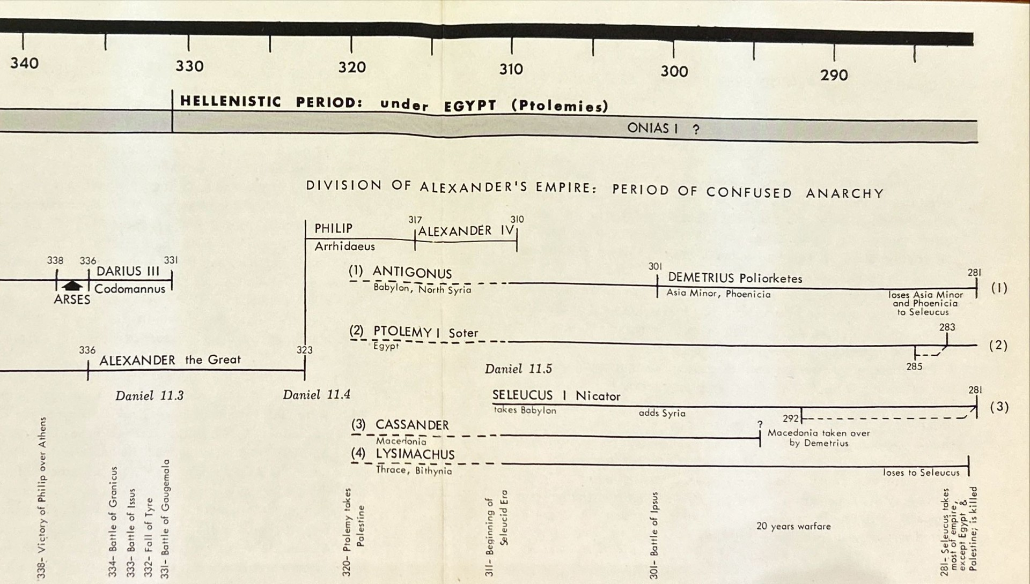

Slide 124
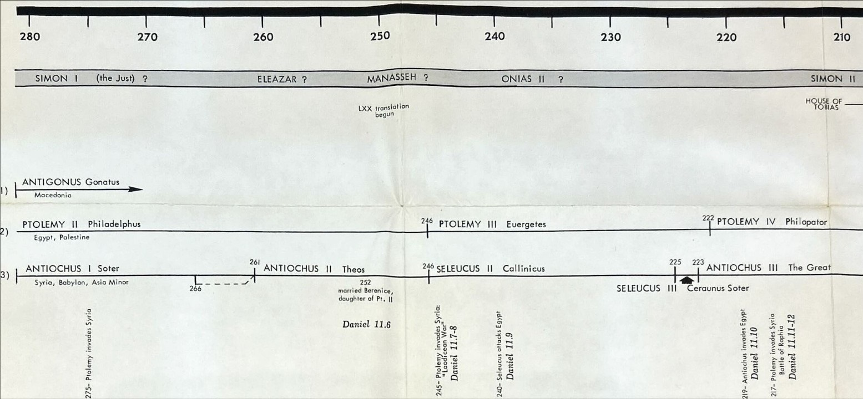

Slide 125
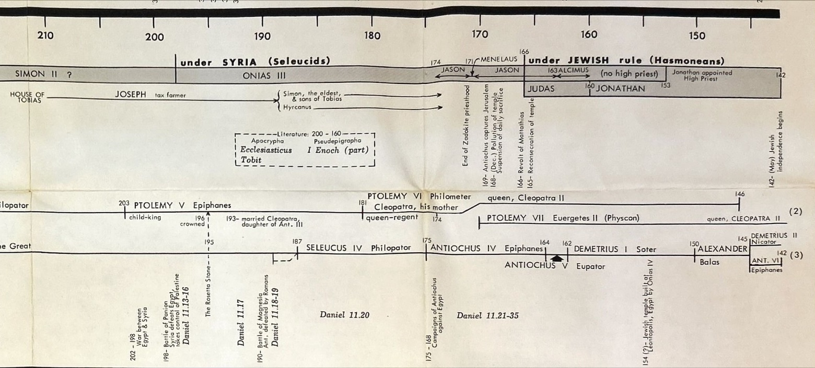

Slide 126
Porphyry
Said there was a 4th conflict between Antiochus and Egypt
The 15 books of Porphyry are lost, and we have only the fragments of his works found in the commentary of Jerome on the book of Daniel.

Slide 127
Between the Old & New Testaments

Slide 128
Daniel has painted a panorama of predicted history.
God will not desert his people in any of the storms of history.
The providential intervention of God
The ultimate deliverance will be the resurrection.
The Most High Rules!

Slide 129
Daniel 12
v.1—Michael your prince (10:21)
v.2—Sleep
“Many”
Synecdoche
a part stands for the whole
Jesus’ blood was shed for “many” (Mt.26:28)
He gave himself a ransom for all (1Tim.2:6)
Ro.5:12—death passed upon all
Ro.5:15—many died as a result of Adam’s sin
All that are in the graves shall come forth (Jn.5:28,29)

Slide 130
Everlasting (Heb. olam)
(Greek aionios)
Life
Shame
Contempt

Slide 131
v.3
They that be wise

Slide 132
v.4
Seal the book
Run to and fro, knowledge increased

Slide 133
v.5
The river—the Tigris (10:4)

Slide 134
v.6
How long shall it be to the end of these wonders?

Slide 135
v.7
Held up his right hand and his left
Time, times, and an half

Slide 136
Dan.7:25—a time and times and the dividing of time
Dan.12:7—a time, times, and an half
Rev.11:2—forty-two months
Rev.11:3—1,260 days
Rev.12:6—1,260 days
Rev.12:14—a time, and times, and half a time
Rev.13:5—forty-two months
Num.14:34; Ezekiel 4:6
a day for a year

Slide 137
Some have called Antiochus Epiphanes
The Mosaic Age Antichrist
In chapter seven we saw predicted
A Christian Age Antichrist

Slide 138
Antichrist (Pseudo-Christ)
His look was more stout than his fellows
He would make war with the saints and prevail against them
He would speak great words against the Most High
He would wear out the saints of the Most High
He would think to change times and laws
Until . . .
A time, and times, and the dividing of time

Slide 139
533AD—Pope Head of all the Churches,
Universal Father
1793AD—French Revolution
Broke the back of the papal dynasty

Slide 140
Gradualness
Babylonian Captivity occurred in three phases:
Daniel and his Friends
Ezekiel and his Peers
Destruction of Jerusalem & Temple
There were three returns from Babylonian Captivity:
Zerubbabel to Rebuild Temple
Ezra to Restore the Law
Nehemiah to Rebuild the Wall

Slide 141
Gradualness
The development of the great apostasy was gradual.
“The Babylonian Captivity of the Church”
The dissolution of the papal power was gradual.

Slide 142
1,290 years
1793 + 30 = 1823A.D.
Election of Pope Leo XII
Elected by the zelanti, conservatives
A hated and unpopular pope, death in 1829.
Wanted to be a spiritual leader,
Cease to rely on political action
Not politics, but religious renewal

Slide 143
1,335 years
1823 + 45 = 1868A.D.
We’ve come thru Garibaldi,
“The Hero of Two Worlds”
The Revolutions of 1848 & 1860
Pope Pius IX—most important pope in modern history (1846-1878)
The last Pope-King

Slide 144
Pope Pius IX
By 1868, he has seen all his dominions with the exception of Rome and its immediate environs annexed to the new kingdom of Italy.
(1854—the immaculate conception of Mary)
1868—the First Vatican Council was called,
to decree the infallibility of the pope
In 1870 he got this decree made

Slide 145
1870—Rome was incorporated into the Italian State
“The Prisoner of the Vatican”
For 59 years after the taking of Rome,
No pope would set foot outside the Vatican,
No pope would enter Rome’s church buildings
No pope would retreat to the papal villa in the nearby hills
To leave the little Vatican patch of land would have been to admit that he was no longer “the prisoner of the Vatican”.

Slide 146
Pope Pius IX
He was pope longer than any other man has ever been pope.
When he died, he had created the modern papacy, stripped of its temporal dominion.
During his funeral procession in 1881, mob pelted the procession with rocks, threatened to throw the pope’s corpse into the Tiber River.
Modern Italy was founded over the dead body of Pope Pius IX.
The greatest foe to the creation of modern Italy was the pope.

Slide 147
What happened in 1868 triggered all this.
The other day, Pope Francis appointed Cardinal McElroy, bishop of San Diego, to lead the Archdiocese of Washington D.C.
to fight President Trump.
Nobody cares.
The pope is a relative nonentity now.

